Slide 1
Groovy Script
ow

Slide 2
Overview
Groovy Script is a java based object oriented programming and scripting language which runs on Java Virtual Machine.
Groovy has very similar syntax with Java language. Groovy 1.0 was released in 2007. Its currently released version is 2.4 and distributed via the Apache License.
Closures, multiline scripts and expressions embedded in strings can be used in groovy script. It is not a replacement for Java, but enhancing Java with some dynamic features.

Slide 3
Features of groovy
Support for both static and dynamic typing.
Support for operator overloading.
Native syntax for lists and associative arrays.
Native support for regular expressions.
Groovy is simple for Java developers since the syntax for Java and Groovy are very similar.
Existing Java libraries can be used.
Groovy extends the java.lang.Object.

Slide 4
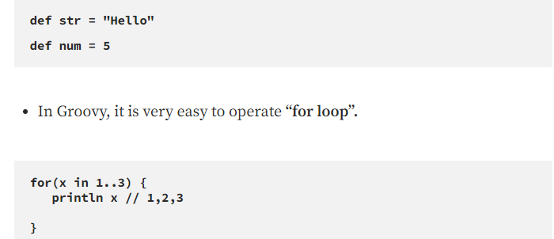
Groovy syntax
Groovy is a dynamic language. It is not mandatory to specify data types like String, int, float etc. A variable can be defined using “def” keyword, and type is judged by Groovy according to the value of the object.

Slide 5
Jenkins pipeline
Agent: Slave on which jenkins pipeline is executed.
Stage: A stage is a block in which tasks are performed through a jenkins pipeline.
Stages: Block that includes multiple stage in a pipeline.
Steps: All the tasks performed in any stage.

Slide 6
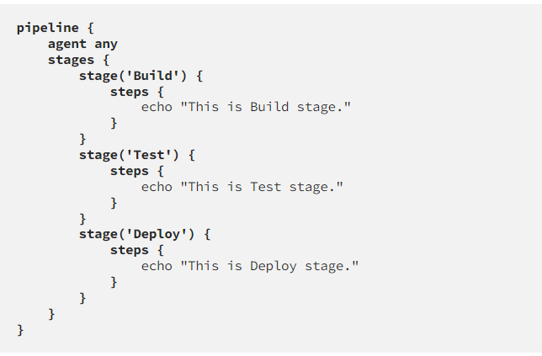
..

Slide 7
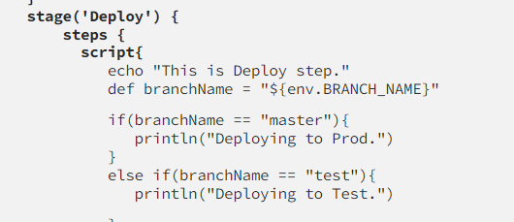
..
Script: Block that can be defined in any stage to provide more functionality to the pipeline using Groovy scripts.

Slide 8
..
Usage of Groovy Script in Jenkins
Groovy script can be used in Jenkins file to build more complex pipelines. Jenkins file is written and submitted to the project source repository. When a commit arrives, Jenkins pipeline is triggered, and all the stages in pipeline are executed according to the algorithm written in Jenkins file.

Slide 9
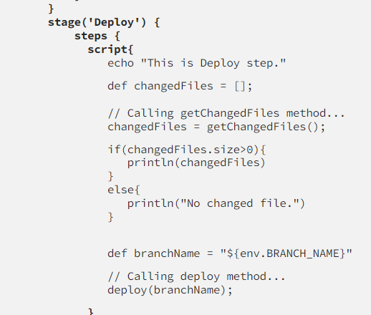
//Code snipper

